Slide 1


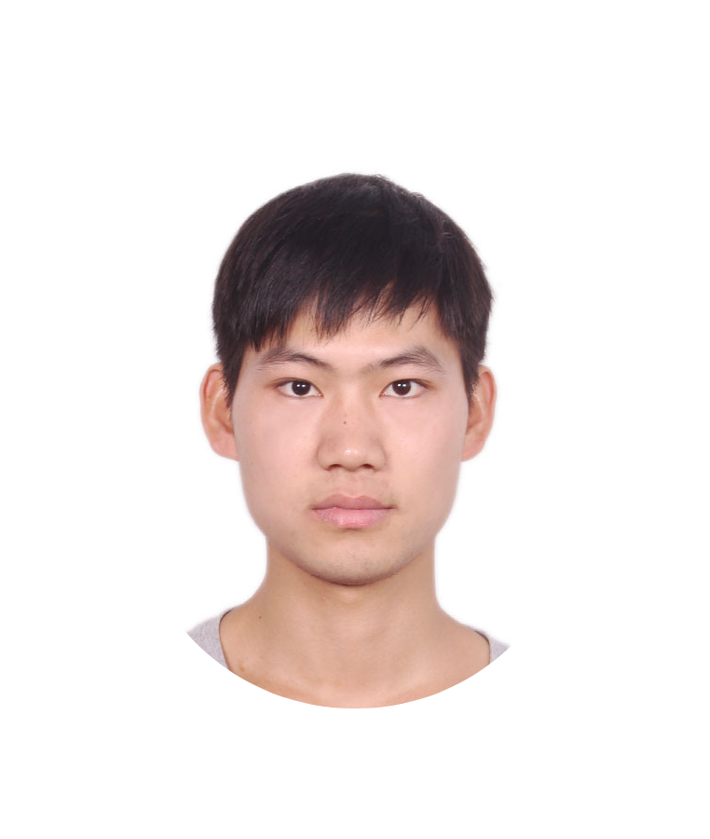

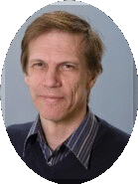
Champion of Weakly-supervised Semantic Segmentation Track
Mining Cross-Image Semantics for Weakly
Supervised Semantic Segmentation
Guolei Sun
Wenguan Wang
Luc Van Gool
ETH Zurich
Learning from Imperfect Data (LID) Workshop

Slide 2
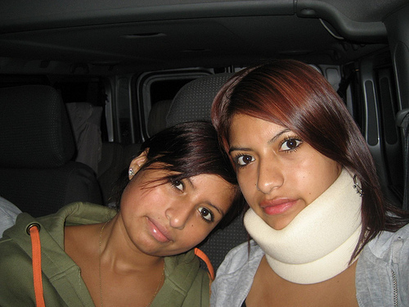
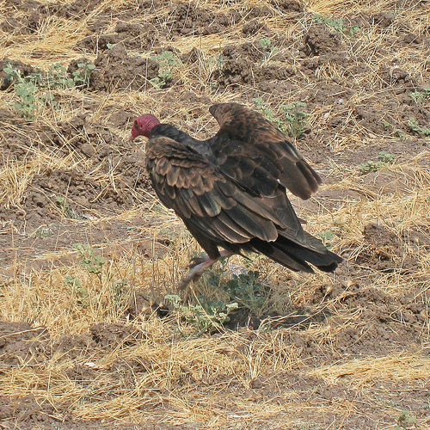
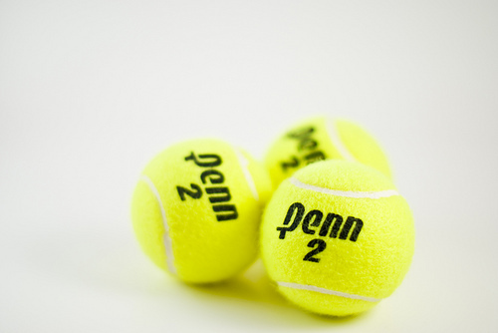

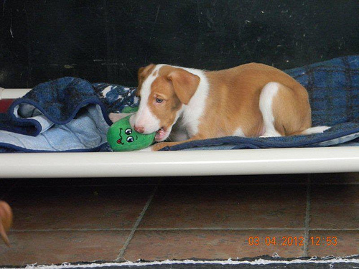

Problem Setting
Weakly Supervised Semantic Segmentation (WSSS) :
Training semantic pixel-wise segmentation using Image-level
labels only.
Person
Bird
Tennis
Bear
Neck brace
…
Training
Test
MODEL

Slide 3
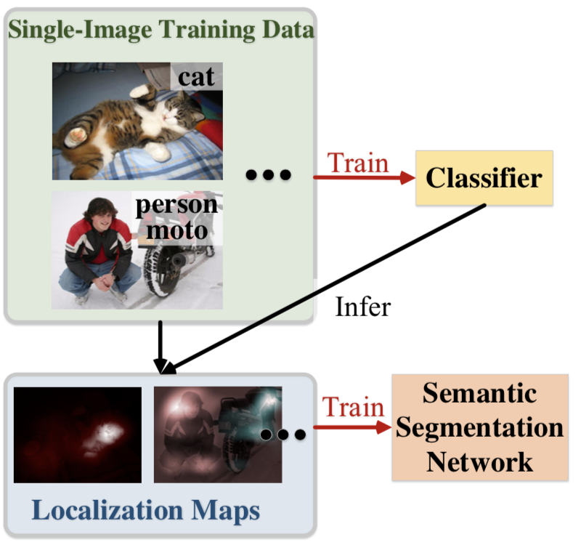
Current Methods
Pipeline: train classifier by single-image data, generate pseudo
ground-truth, and train fully segmentation network

Slide 4
Limitations
Only intra-image information is used
Rich cross-image relation is ignored

Slide 5
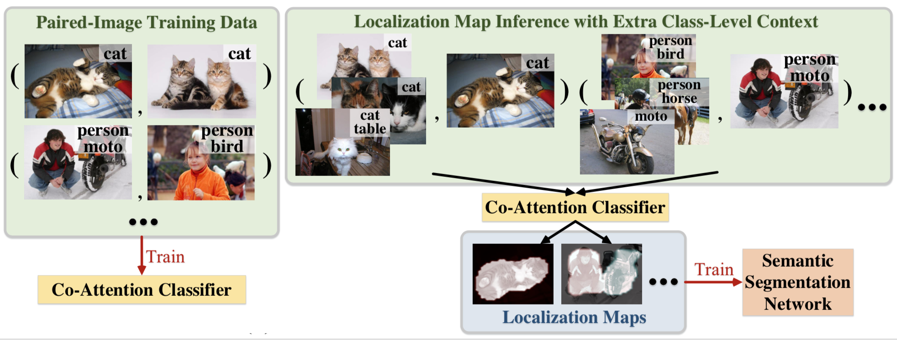
Our Main Idea
Exploit cross-image semantics for comprehensive object pattern mining

Slide 6
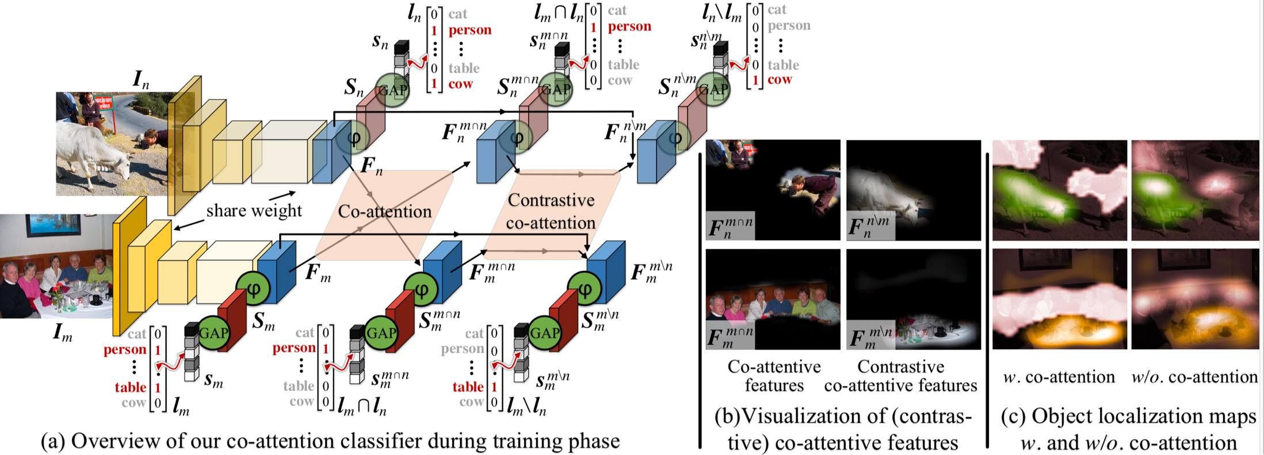
Our Approach
Siamese network is used to mine the relation between image pairs
Co-attention: mine the cross-image common semantics
Contrastive co-attention: mine the cross-image exclusive semantics

Slide 7
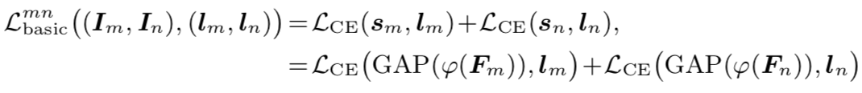
Our Approach
Basic classifier: individual-image information is explored
Siamese network
Sigmoid cross entropy

Slide 8
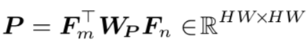
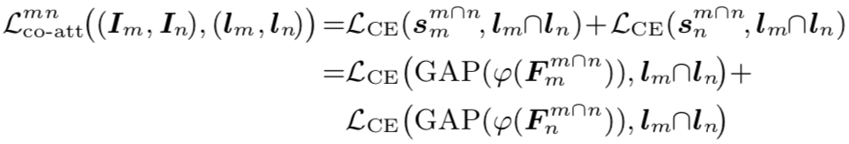
Our Approach
Co-attention: mine the cross-image common semantics
Affinity matrix
Co-attention matrix
Co-attention features
Co-attention loss

Slide 9
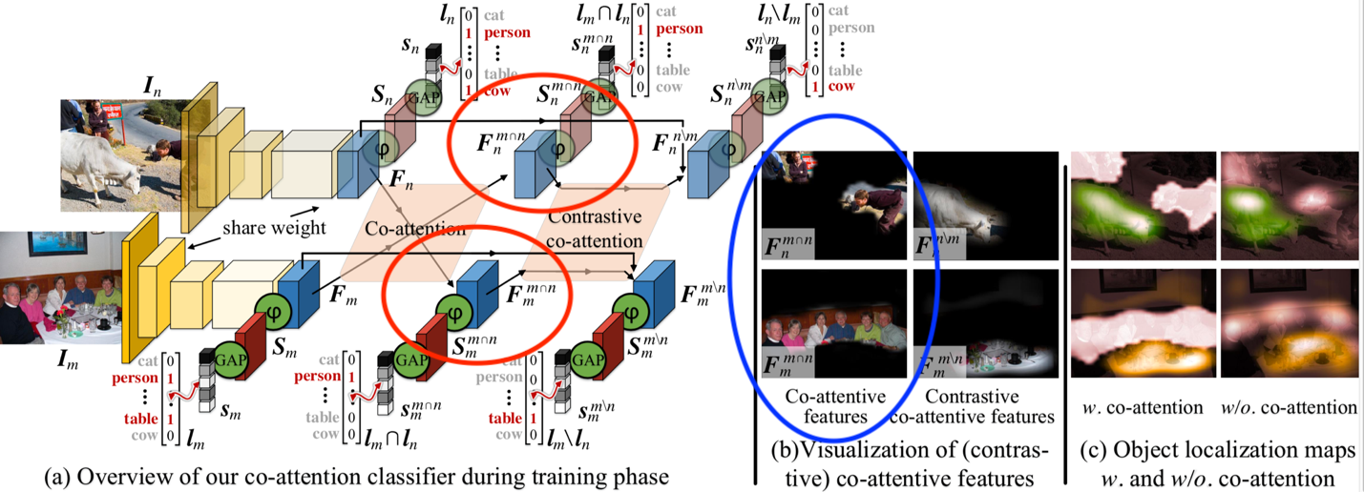
Our Approach

Slide 10
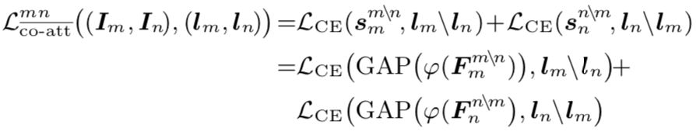
Our Approach
Contrast co-attention: mine the cross-image exclusive semantics
Class-agnostic co-attentions
Contrast co-attention matrix
Contrast co-attention features
Contrast co-attention loss

Slide 11
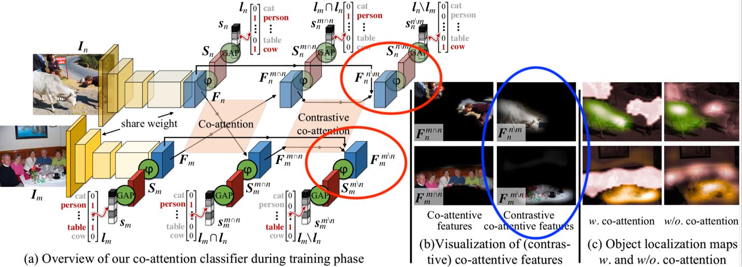
Our Approach

Slide 12
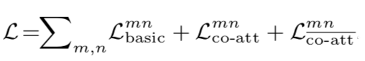
Our Approach
Overall loss
In-depth discussion
Auxiliary-task learning: predict the common and uncommon semantic
Image co-segmentation: use knowledge of images share/unshare semantics

Slide 13
Our Approach
Full steps of our approach
Train the proposed co-attention classifier (ResNet-38)
Obtain localization maps
Use AffinityNet [CVPR 18] to generate pseudo ground truth (GT) (without using saliency maps)
Use pseudo GT to train fully segmentation model: Deeplab V3+ (ResNet-101)

Slide 14
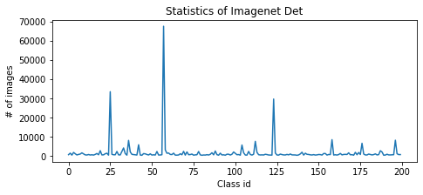
Experiments
LID Challenge Dataset (Imagenet Det) overview
# of training images (image-level labels): 349319
# of validation images: 4690
# of test images: 10000

Slide 15
Experiments
Challenges for this dataset
Huge class imbalance across classes
Huge ratio of negative/positive samples for most classes
Noisy labels
Solutions specifically designed for this dataset
Balanced sample images according to small classes
Weighted sigmoid cross entropy (wsce) loss
Refine noisy labels by first training a strong classifier
Additional trick
Integral attention learning [ICCV 19]: initial localization maps are used as
soft labels for learning more integral localization maps

Slide 16
Experiments
Ablation study
 | # of images | Val (mIoU)
Random sample | 20k | 31
Balanced sample | 20k | 33
Balanced sample + wsce loss | 20k | 36
Balanced sample + wsce loss + label refine | 20k | 38
Balanced sample + wsce loss + label refine | 200k | 45

Slide 17
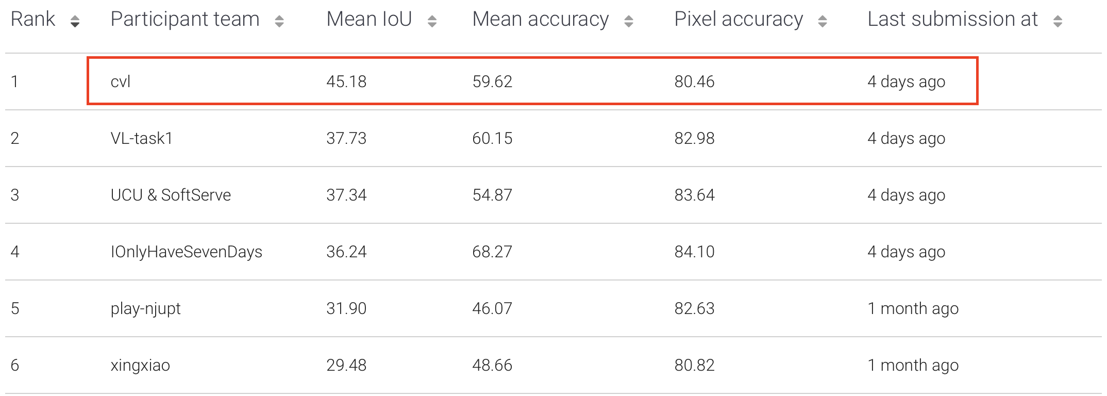
Experiments
Results on test set

Slide 18
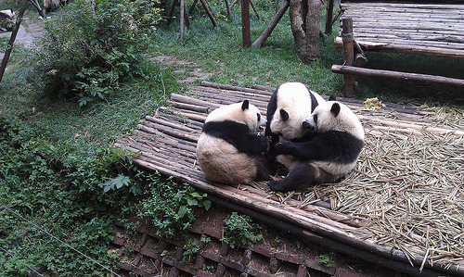

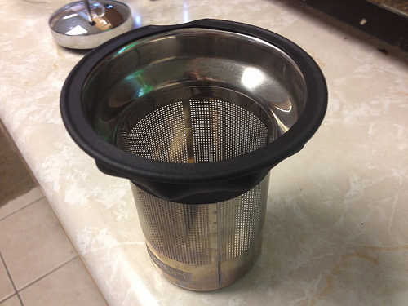

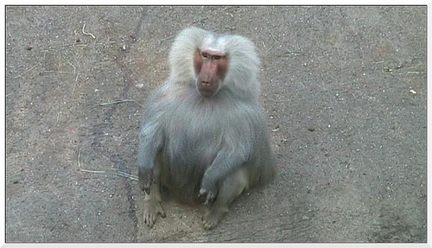

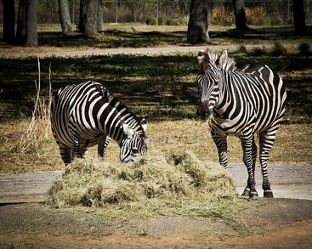
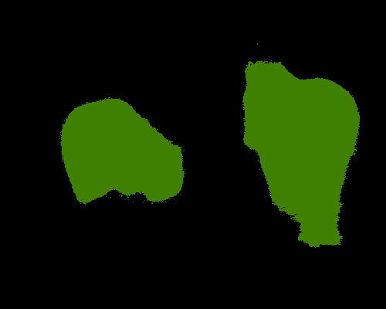

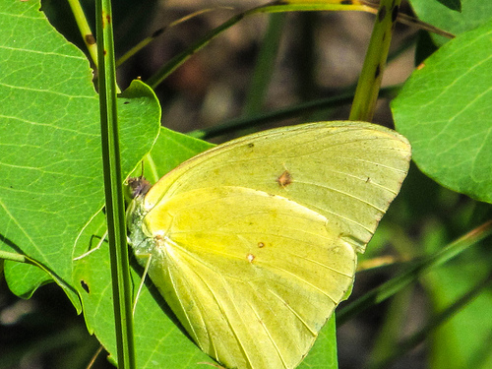

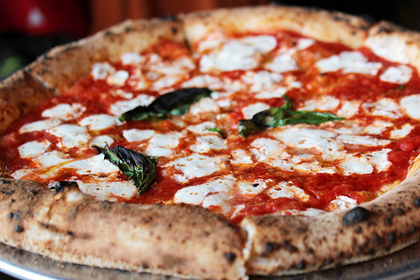

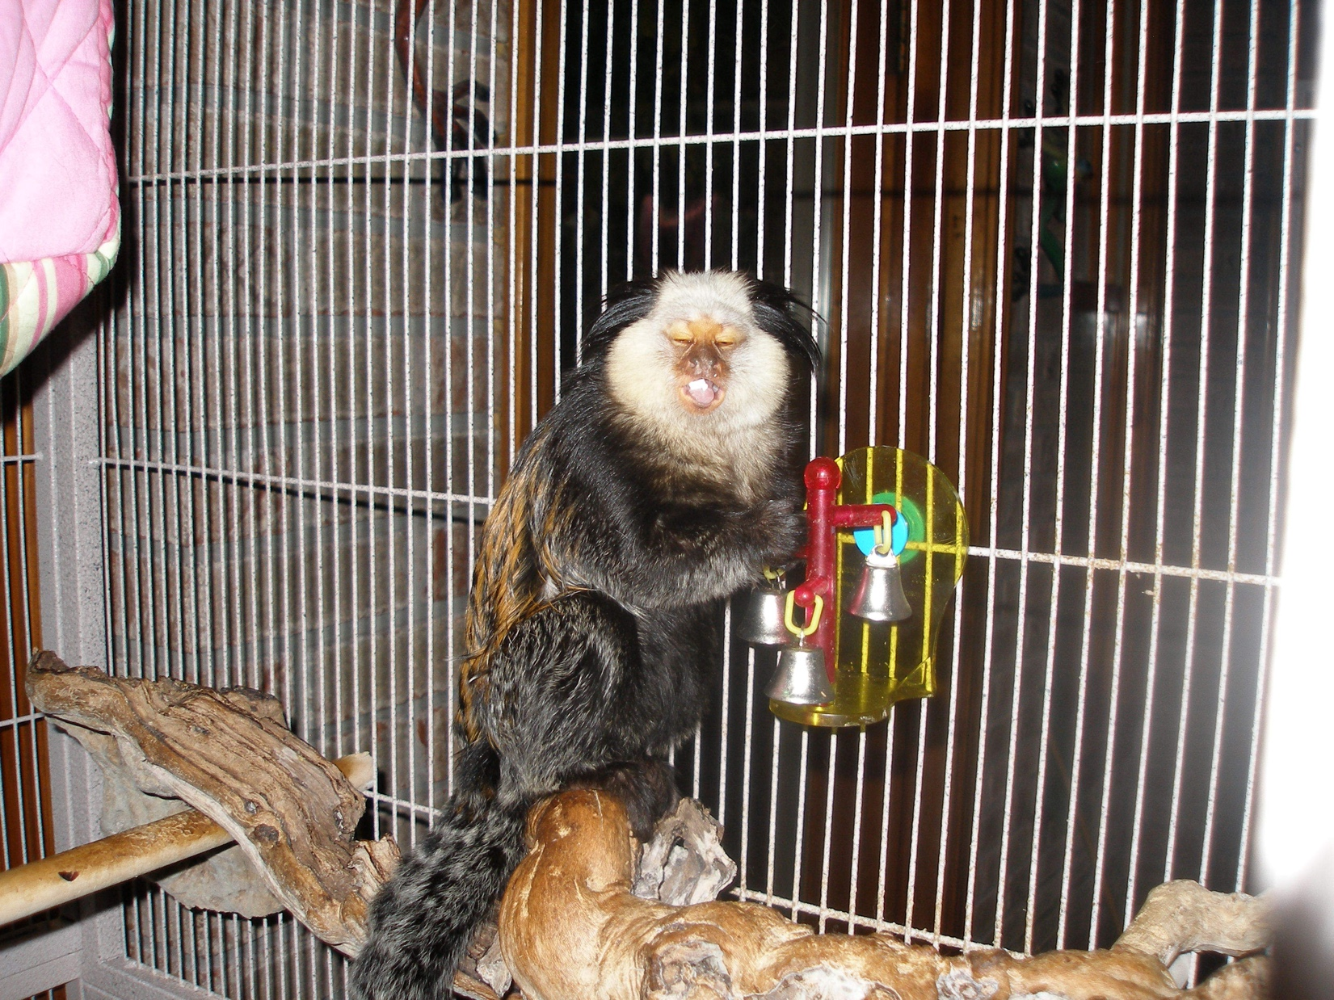
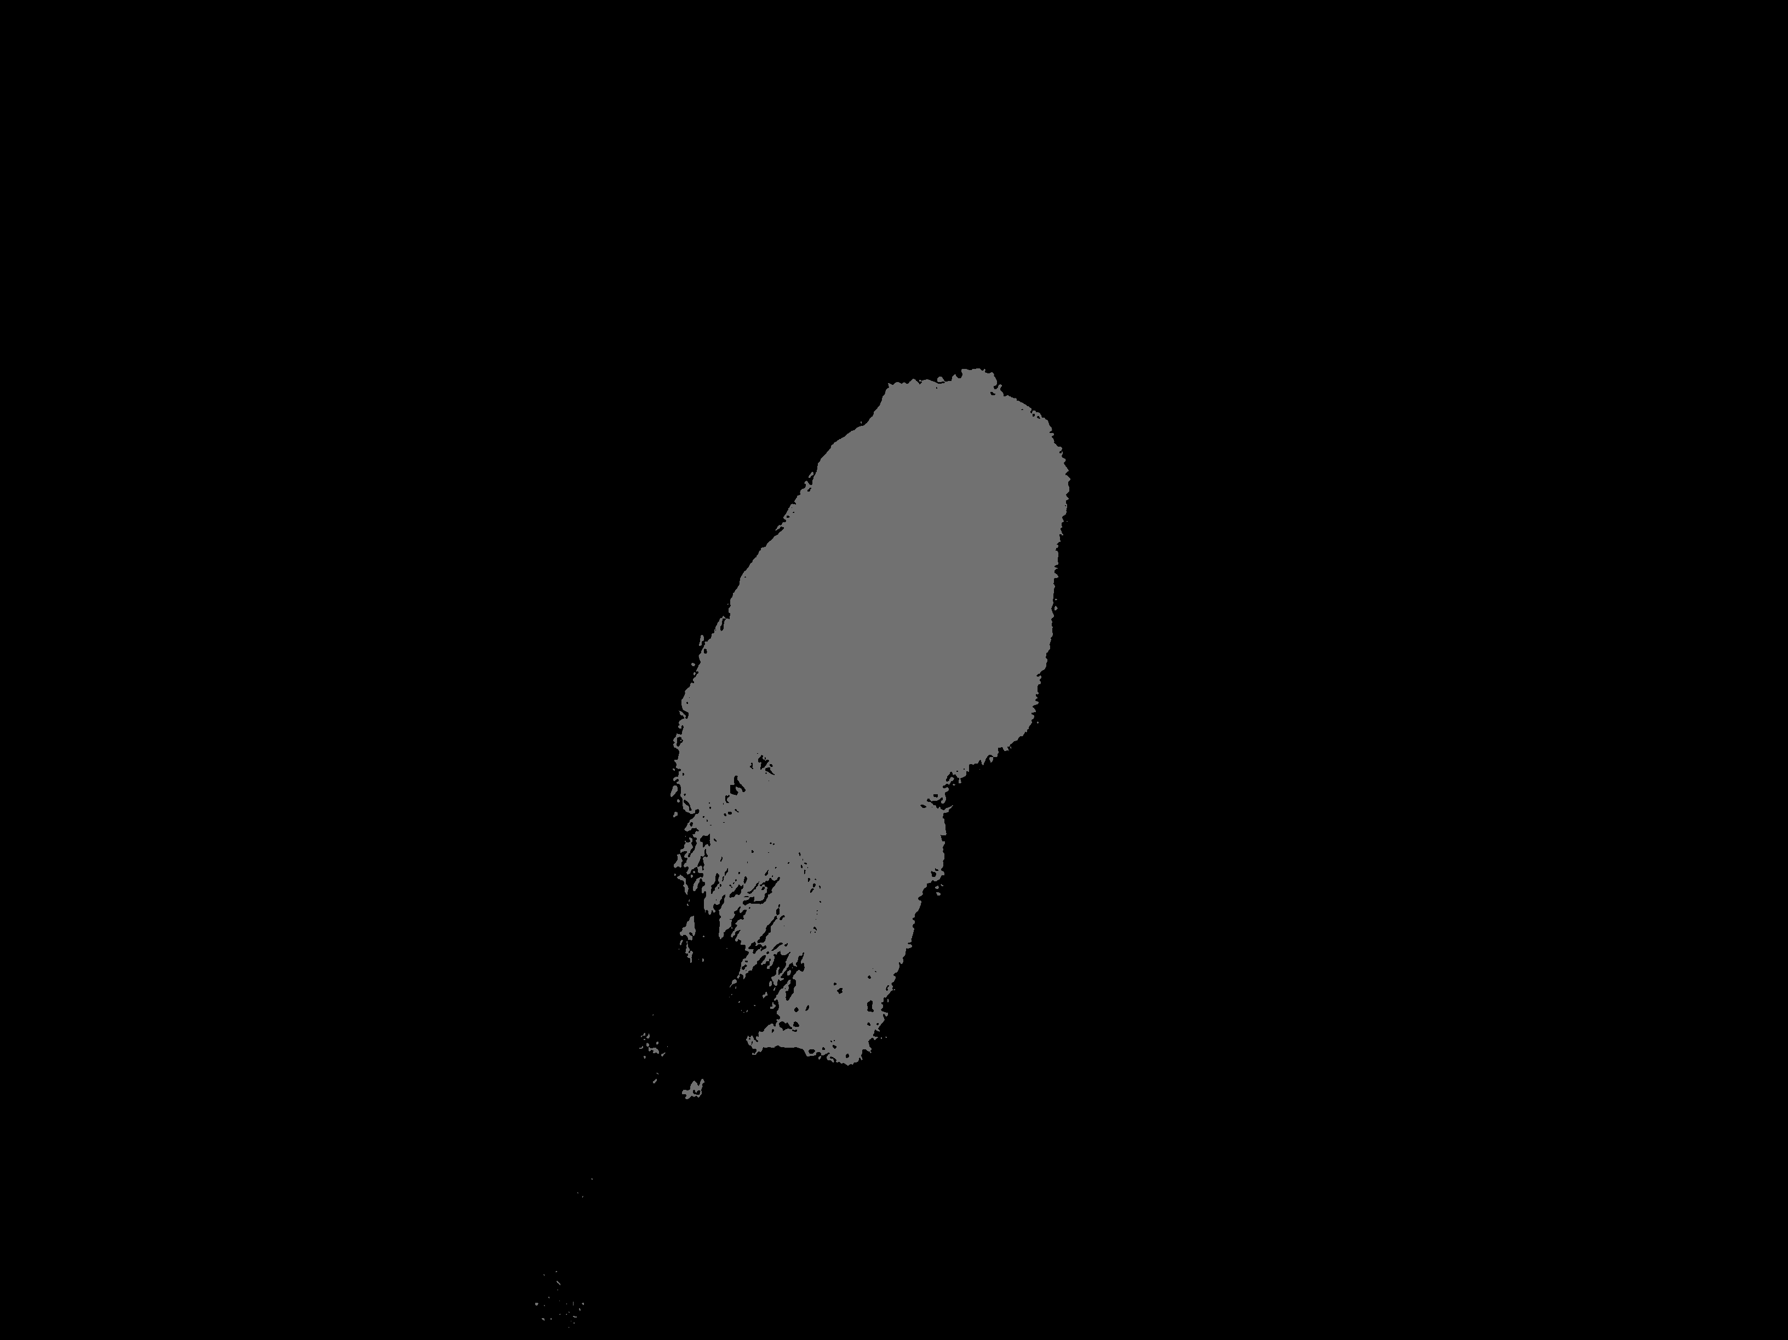
Experiments
Segmentation results

Slide 19
Thanks!

